Slide 1

The Seven Sorrows of Mary
Our Lady of Sorrows
1.Circumcision/Presentation at the Temple
2.Flight into Egypt
3.Finding in the Temple/Among the Doctors
4.Way to Calvary/Carrying of the Cross
5.Crucifixion
6.Deposition/Decesent from the Cross
7. Lamentation/Entombment
Music : Via Dolorosa(Sandi Patti)

Slide 2
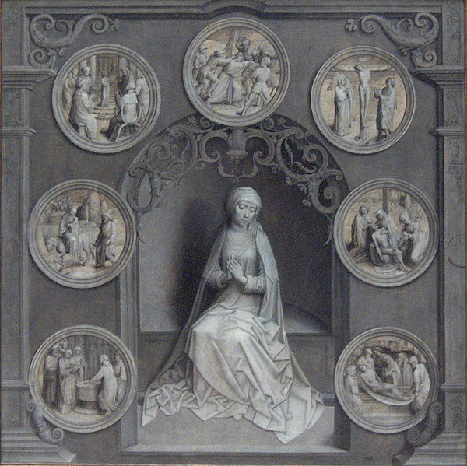
The Seven
Sorrows
of Mary
Way to Calvary
Among the Doctors
Crucifixion
Flight into Egypt
Deposition
Circumcision
Entombment

Slide 3
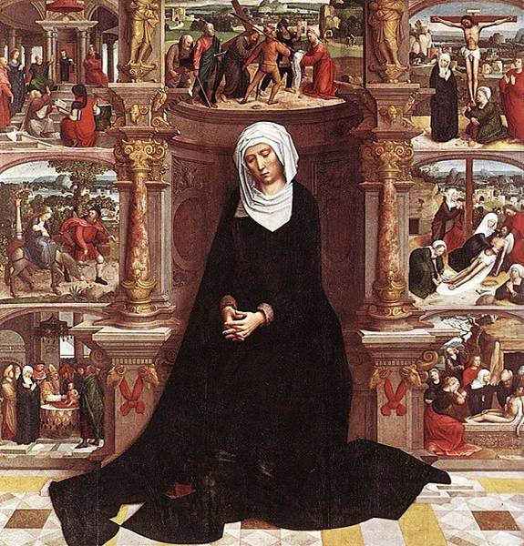
The Seven
Sorrows
of Mary
Adriaen Isenbrant
(1485-1551)和

Slide 4
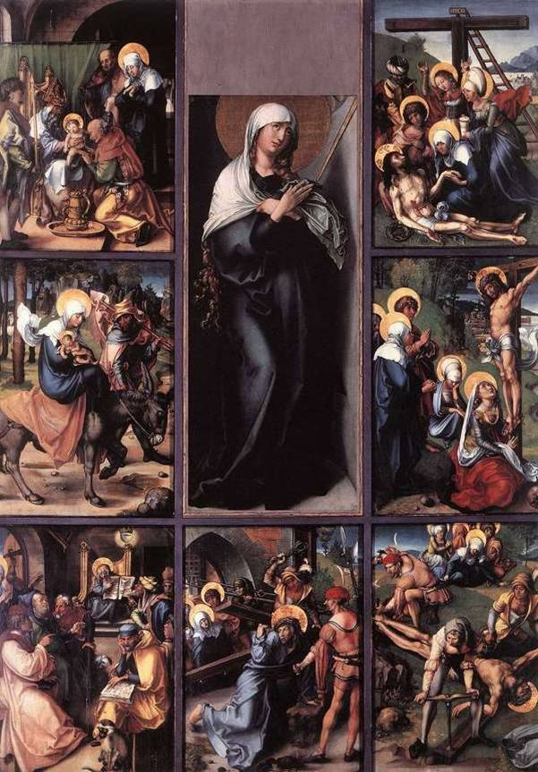
The Seven
Sorrows
of Mary
Albrecht Dürer
(1471-1528)獨

Slide 5
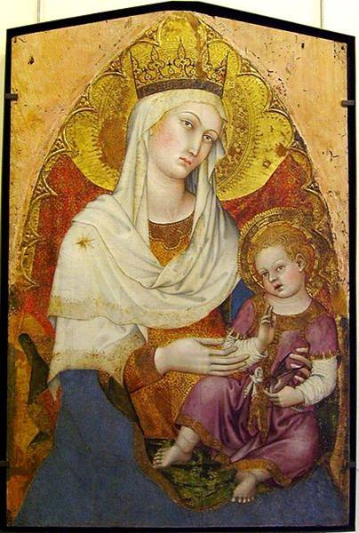
Madonna and Child
Taddeo di Bartolo
(1363-1422)伊

Slide 6
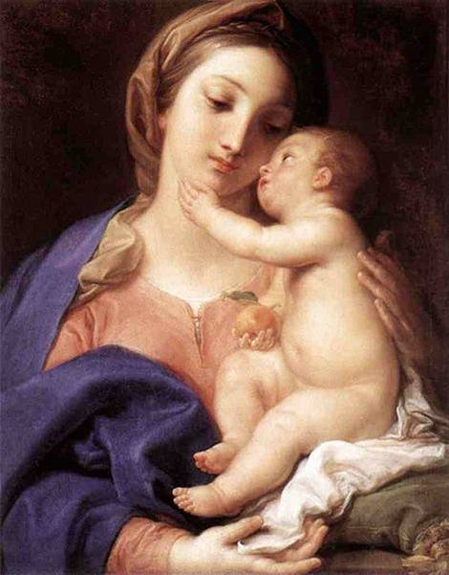
Madonna and Child
Pompeo Batori
(1708–1787)伊

Slide 7
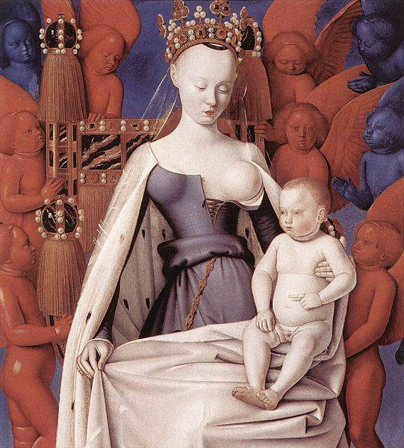
Madonna
and Child
Jean Fouquet
(1420-1481)佛

Slide 8
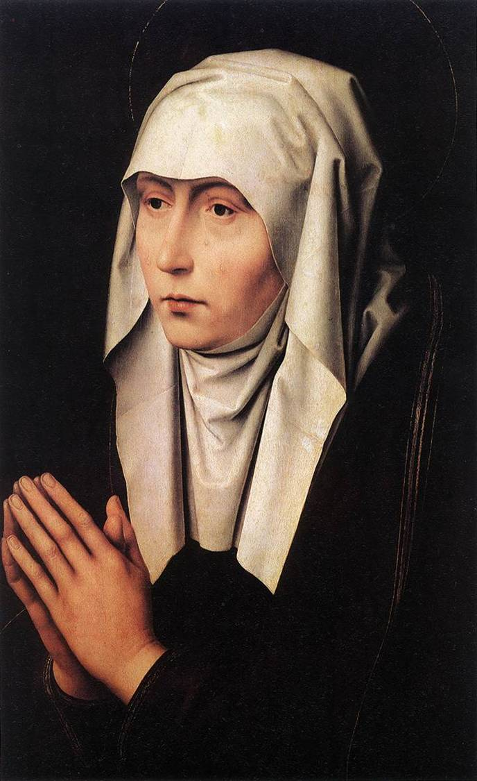
Mater Dolorosa
Hans Memling
(1430-1494)

Slide 9
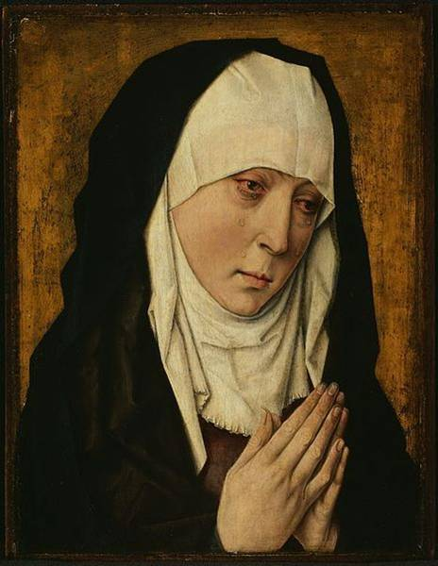
Mater Dolorosa
Dieric Bouts
(1420-1475)和

Slide 10
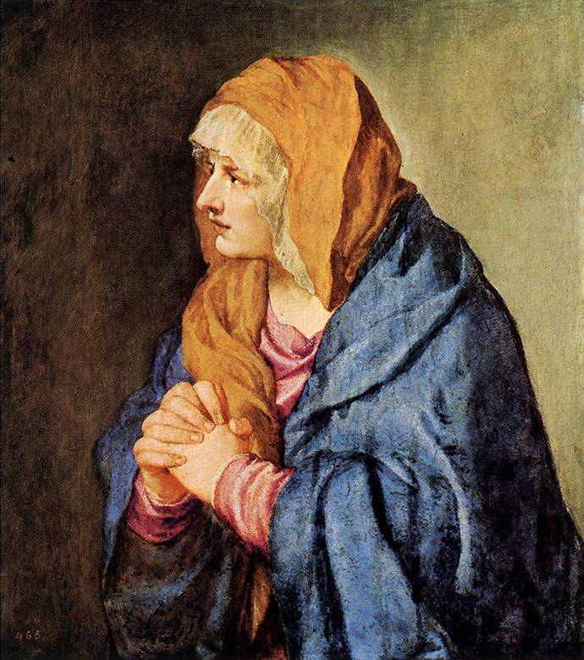
Mater Dolorosa
Titian
(1488/90-1576)

Slide 11
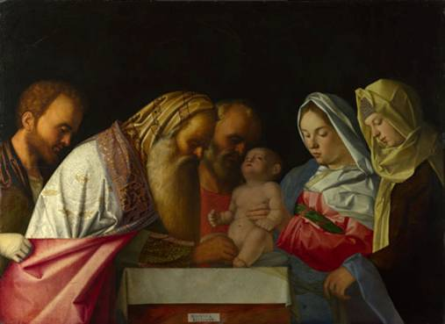
1. Circumcision
Giovanni Bellini(1430–1516)伊

Slide 12
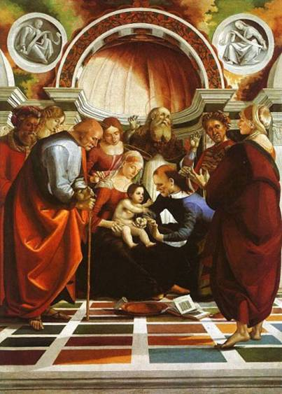
1. Circumcision
Luca Signorelli
(1450–1523)伊

Slide 13
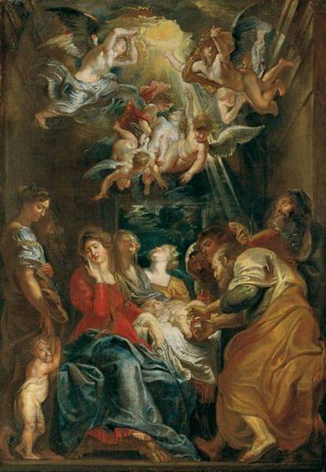
1. Circumcision
Peter Paul Rubens
(1577-1640)和

Slide 14
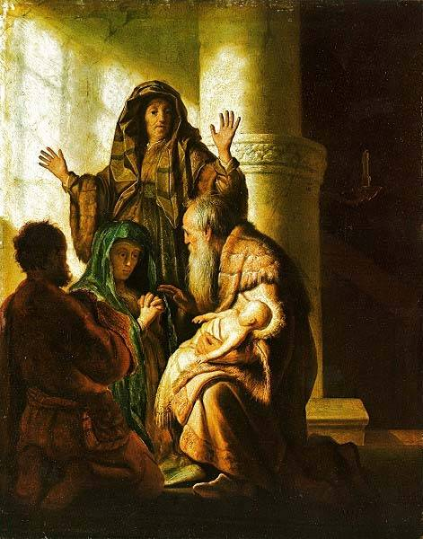
Presentation
at the Temple
Rembrandt
(1606-1669)和

Slide 15
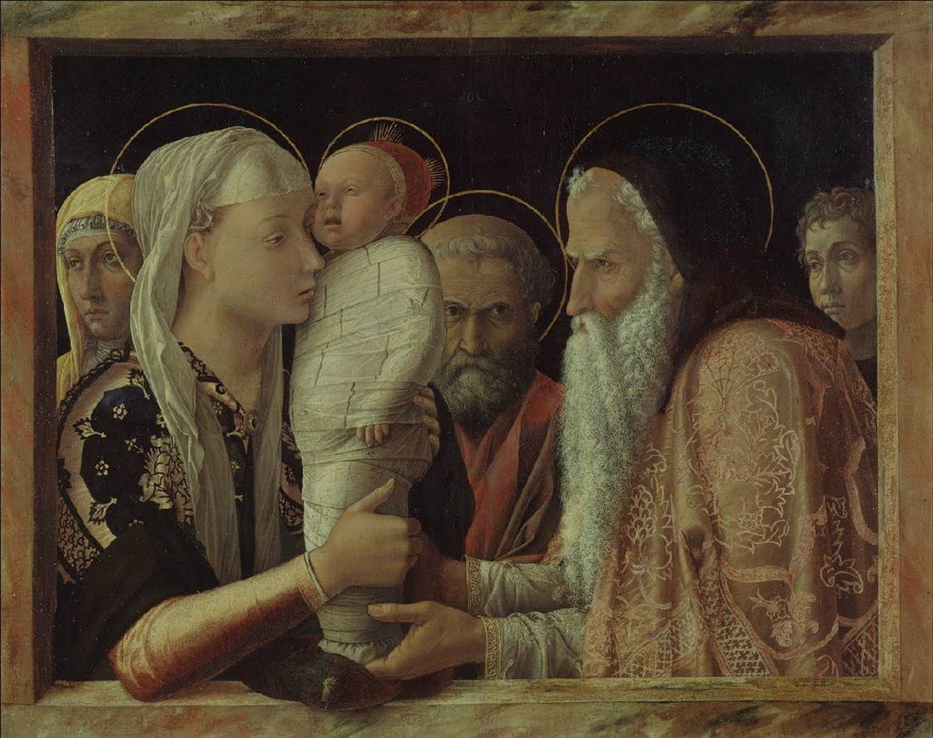
1. Presentation at the Temple
Andrea Mantegna (1431 – 1506)伊

Slide 16
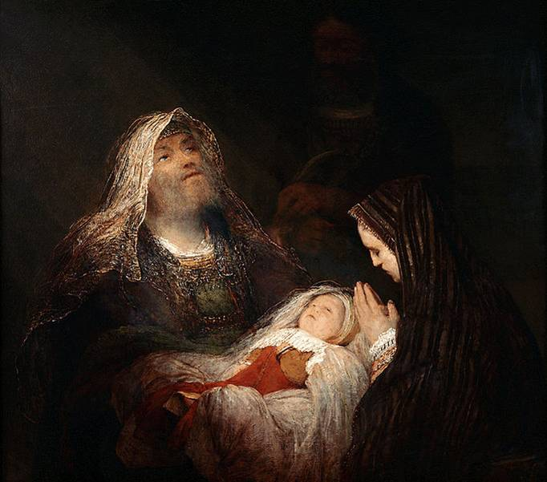
Presentation
at the Temple
Aert de Gelder
(1645–1727)和

Slide 17
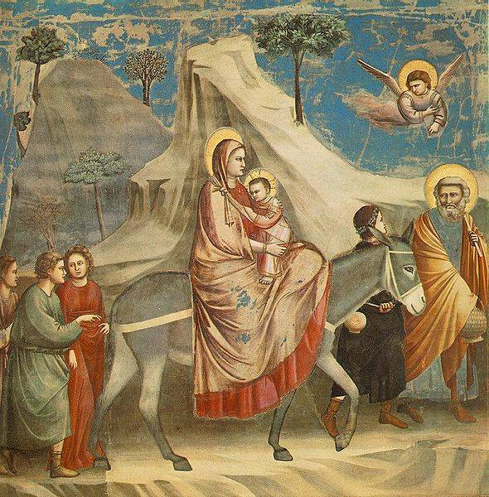
2.Flight into
Egypt
Giotto
(1267-1337)伊

Slide 18
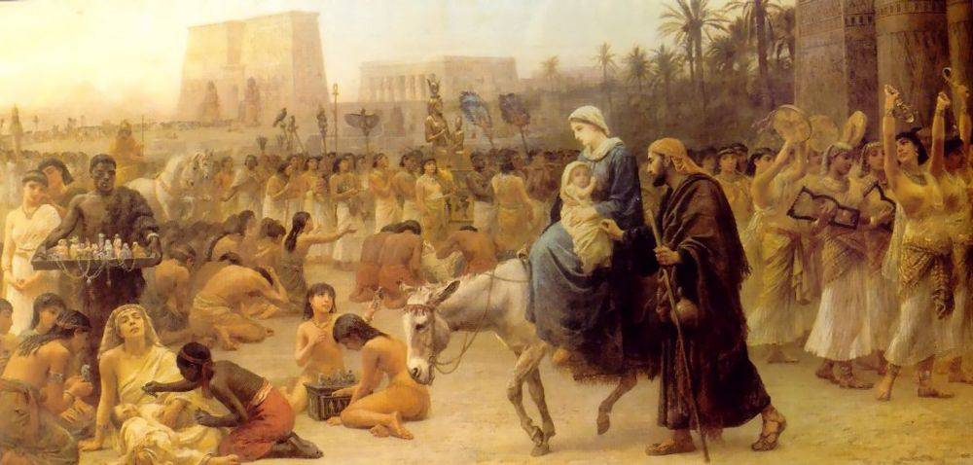
2.Flight into Egypt
Edwin Long(1829–1891)英

Slide 19
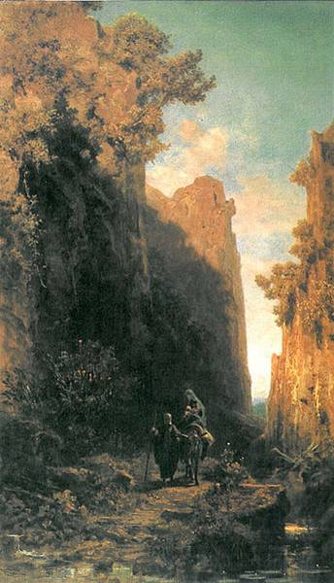
2.Flight into Egypt
Carl Spitzwe
(1808–1885)獨

Slide 20
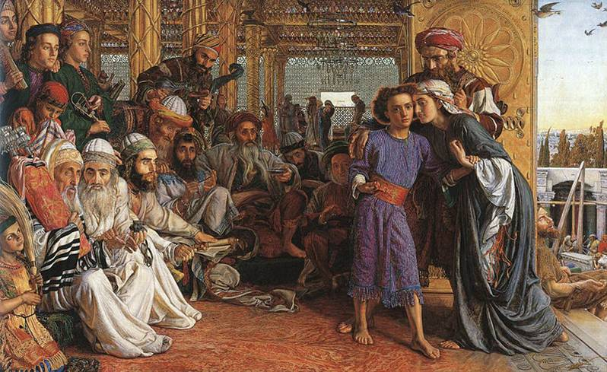
3.Finding in the Temple
William Holman Hunt(1827–1910)英

Slide 21
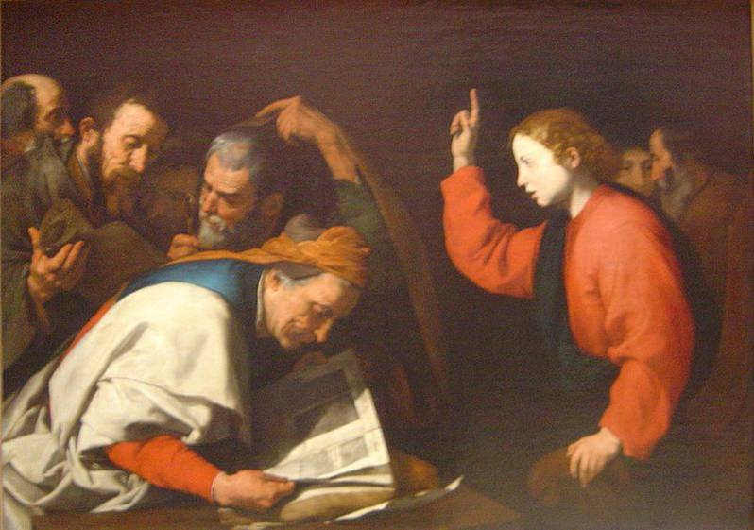
3.Among the Doctors
José de Ribera(1591–1652)西

Slide 22
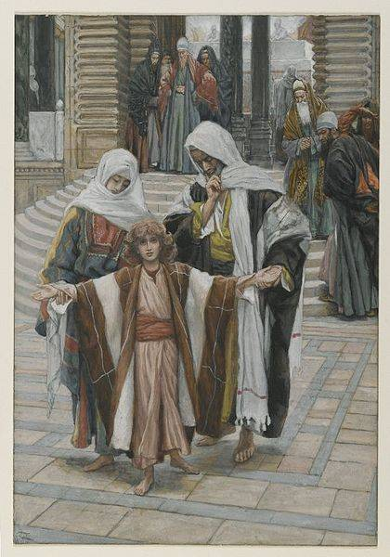
3.Finding in the Temple
James Tissot
(1836–1902)佛

Slide 23
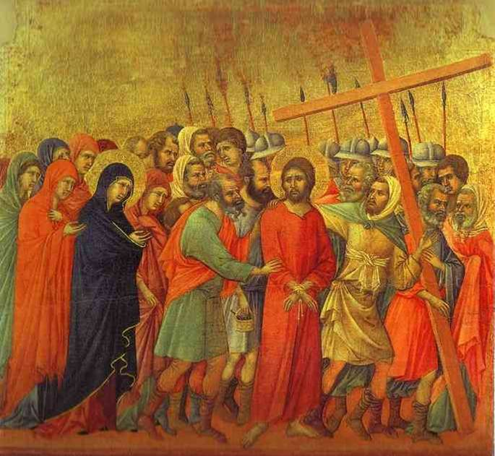
4.Way to
Calvary
Duccio 伊(1255 – 1319)

Slide 24
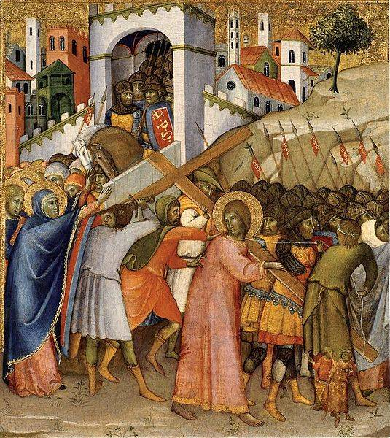
4.Way to Calvary
Andrea di Bartolo
(1360/70-1428)伊

Slide 25
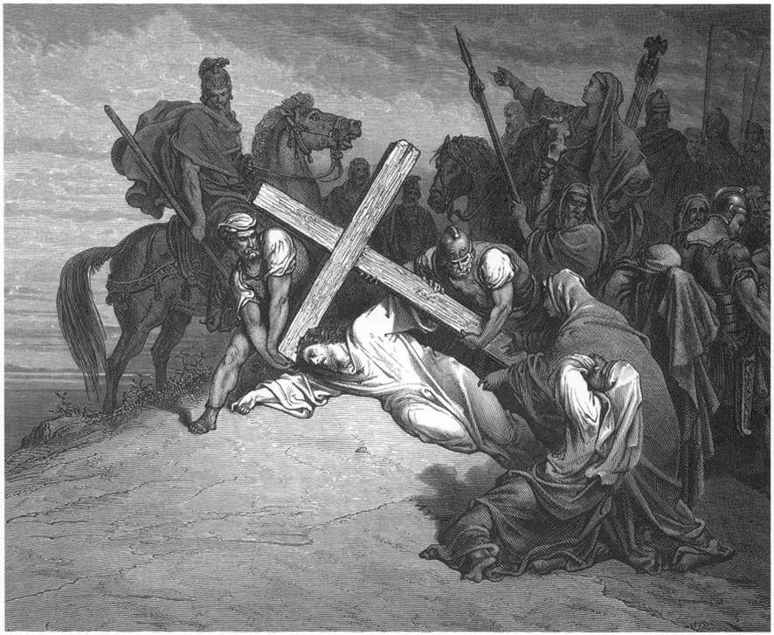
4.Carrying of the Cross
Gustave Doré (1832 – 1883 )佛

Slide 26
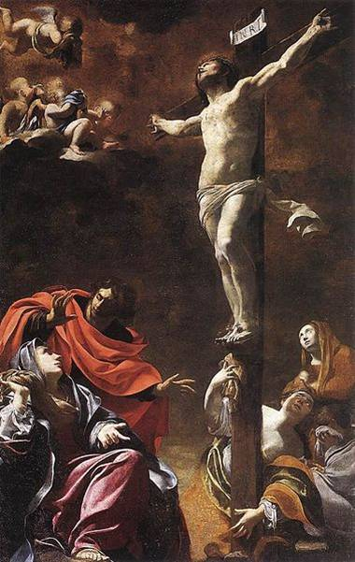
5.Crucifixion
Simon Vouet
(1590–1649)佛

Slide 27
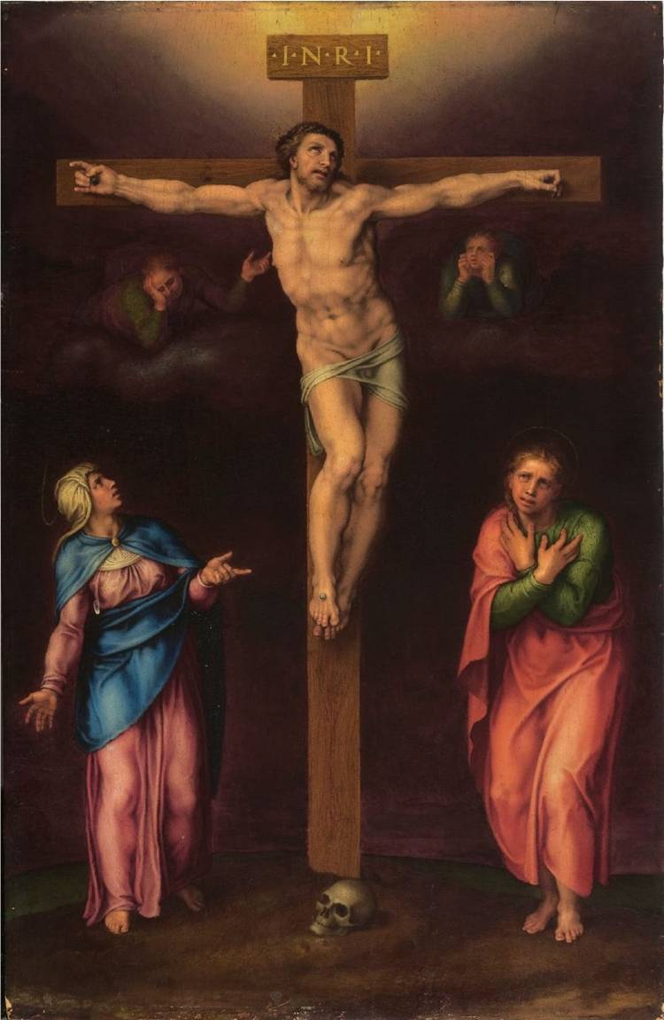
5.Crucifixion
Michelangelo
(1475 – 1564) 伊

Slide 28
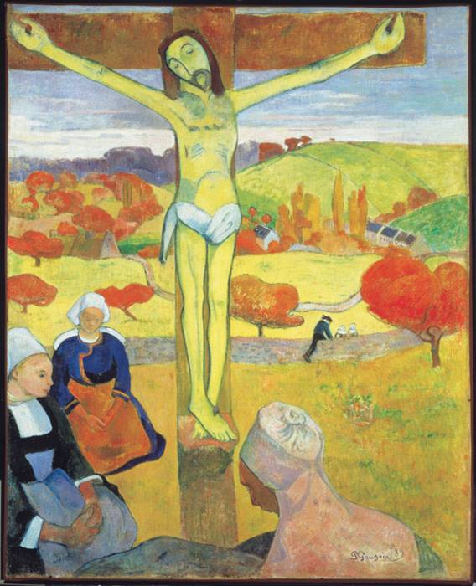
5.Crucifixion
Paul Gauguin
(1848 – 1903 )佛

Slide 29
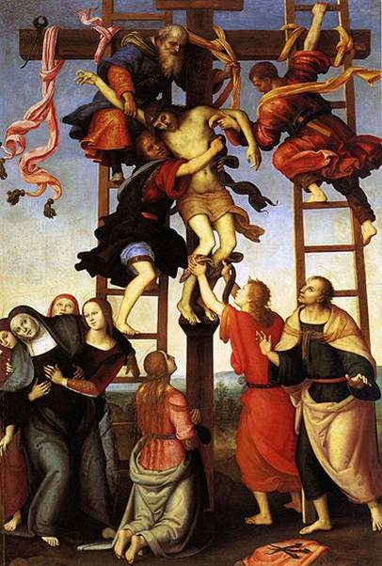
6.Deposition
Pietro Perugino
(1448–1523)伊

Slide 30
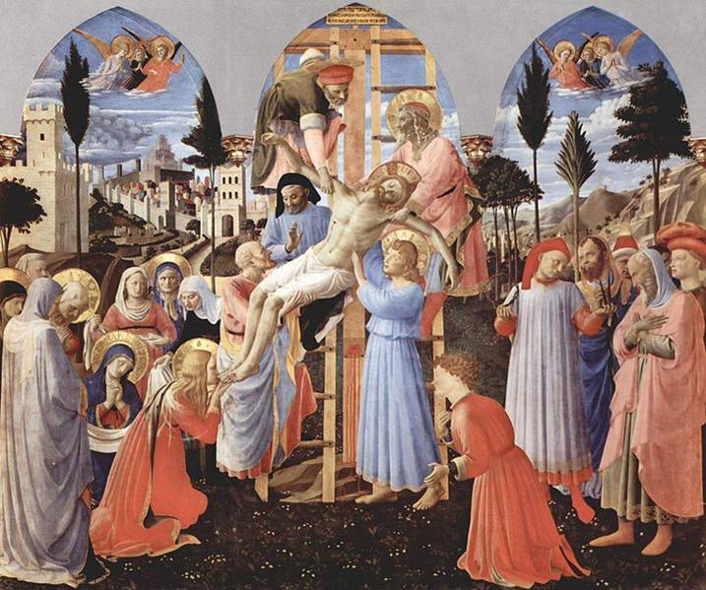
Fra Angelico(1395-1455)伊
6.Deposition

Slide 31
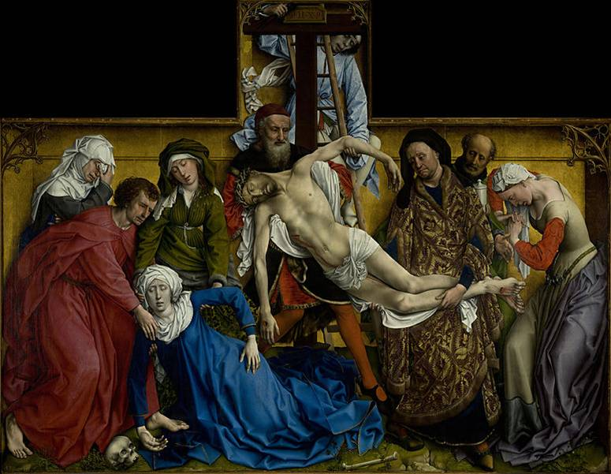
Rogier van der Weyden
(1399/1400–1464)和)
6.Deposition

Slide 32
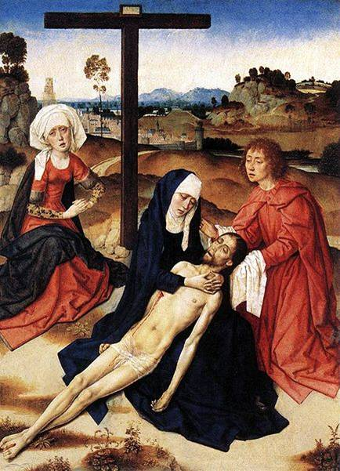
7.Lamentation
(Pietà )
Dieric Bouts
(1420-1475)和

Slide 33
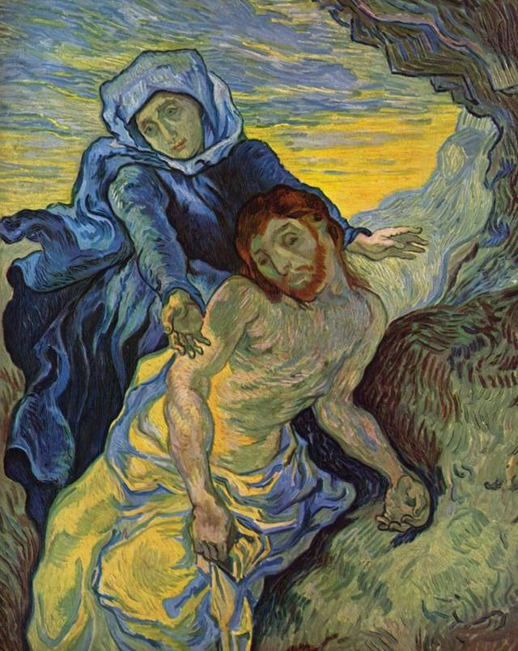
7.Lamentation
(Pietà)
Vincent van Gogh
(1853 – 1890)和

Slide 34
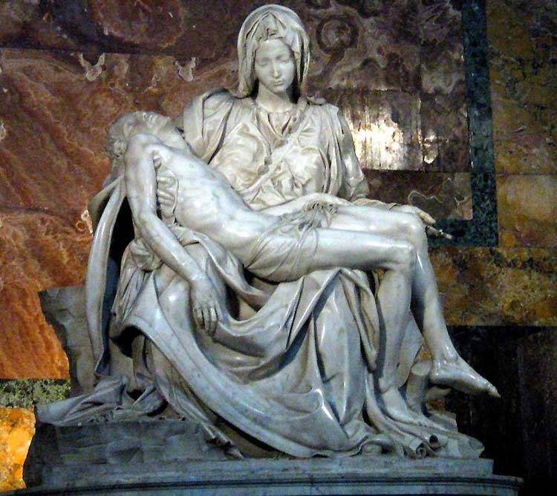
7.Pietà
Michelangel
(1475 – 1564)

Slide 35
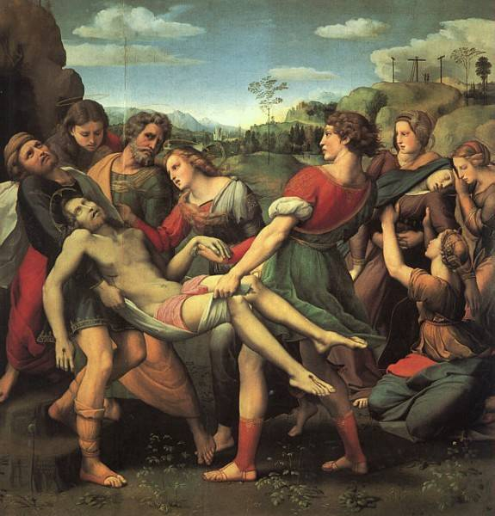
7.Entombment
Raphael
(1483 – 1520)伊

Slide 36
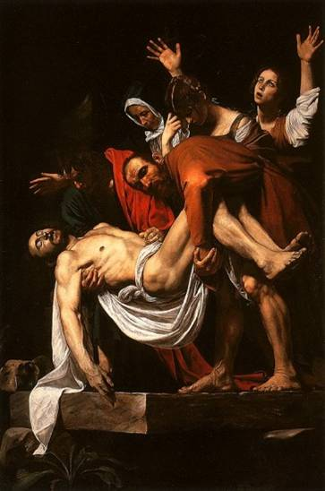
7.Entombment
Caravaggio
(1573 – 1610)伊

Slide 37
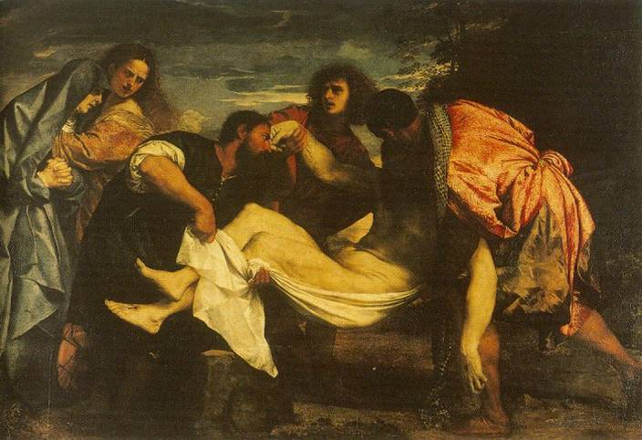
7.Entombment
Titian (1487/90 – 1576)伊

